Slide 1
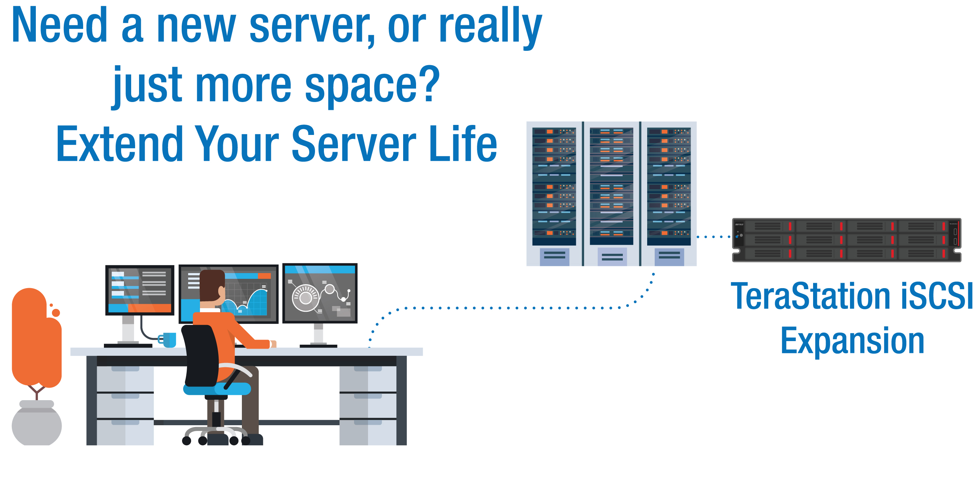
Provide Server Expansion & iSCSI Backup to Customers with storage needs & no budget
How Can a Hybrid Cloud Strategy Benefit Your Customer?
Notes:
mark

Slide 2
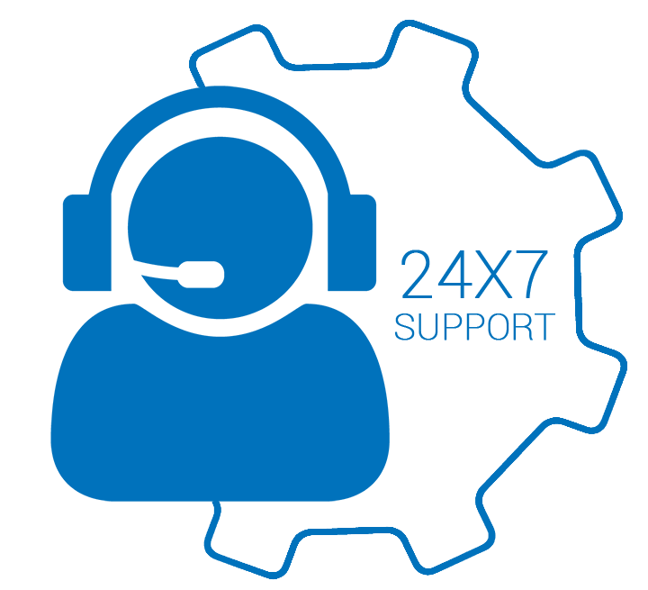
Welcome
Today’s Presenters
Mark Green –
Buffalo Account Manager
Gary Thomas –
Buffalo Sales Engineer
Notes:
mark

Slide 3
Founded in 1974 - 45+ years
Headquarters - Nagoya, Japan
Publically Traded on Tokyo Stock Exchange
North American HQ – Austin, TX
Award winning North American Tech Support
Committed to SMB
Purpose Built Engineered Products & Solutions
Dedicated Pre & Post sales resources
Network Storage & Networking Product Strength
Notes:
mark

Slide 4
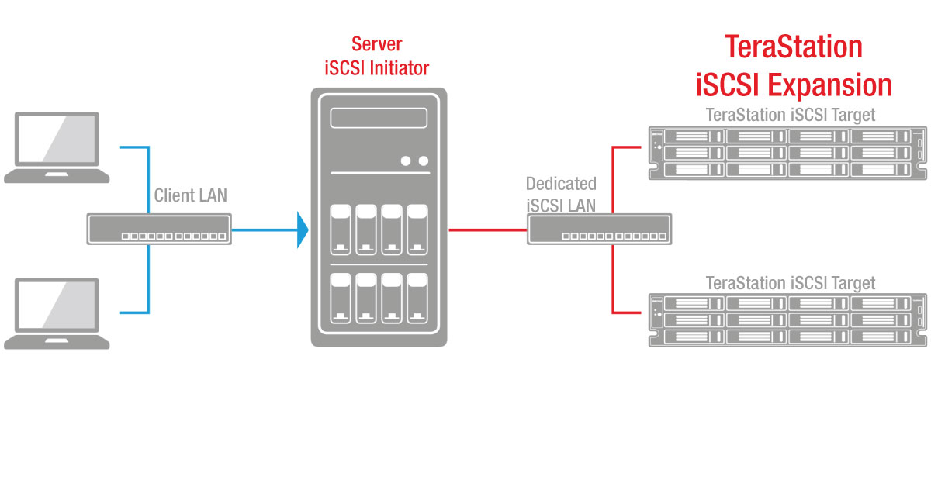
Details about iSCSI
Why is iSCSI Known for Server Expansion?
iSCSI allows a storage array to emulate an internal hard drive in another system
RAID5
Save yourself the hassle of calling different manufacturers for drive or chassis support
Notes:
gary

Slide 5
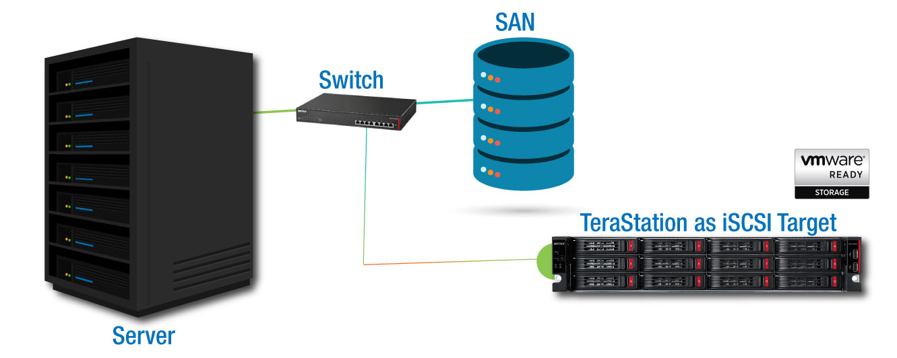
Details about iSCSI
Why is iSCSI relevant?
iSCSI offers the best cost for performance value when adding storage space to a virtual host (server).
$$$
RAID5
Save yourself the hassle of calling different manufacturers for drive or chassis support
$
Notes:
gary

Slide 6
Performance in a Virtual Environment
Benefits
Can provide large amounts of storage to a virtual host (server)
No need to add drives to the host itself
Doesn’t sacrifice performance
Can use existing networking equipment
No need to learn fiber SAN topology configuration
More cost efficient than fiber SAN
RAID5
Save yourself the hassle of calling different manufacturers for drive or chassis support
* A virtual environment is when an operating system creates an environment to host virtual machines (computers).
Notes:
Gary

Slide 7
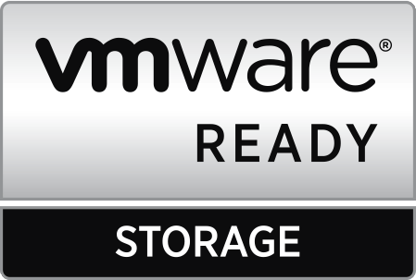
Importance of iSCSI VMware Ready
Why is iSCSI significant to VMware?
VMware ESX provides native support for iSCSI targets. iSCSI is a popular storage option for ESX hosts.
What is VMware Ready?
RAID5
As stated on VMware.com:
VMware Ready designates VMware's highest level of endorsement for products created by our established partners. VMware Technology Alliance Partner members can develop their products to meet VMware standards and submit them for test and review. The VMware Ready certification tests are specifically designed for each category to ensure customer confidence.
Save yourself the hassle of calling different manufacturers for drive or chassis support
If you contact VMware support for assistance with an unsupported storage solution, their ability to help you will be limited *TS5010 & TS6000 only
Notes:
Gary

Slide 8
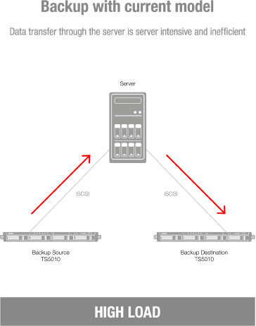
Backing up iSCSI Data
In the past, the only way to back up an iSCSI target on a TeraStation was through the connecting host using OS based backup software.
Notes:
gary

Slide 9
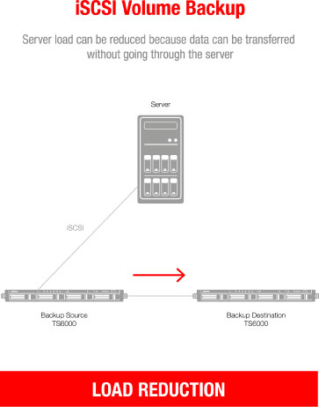
Backing up iSCSI Data
With the introduction of the TeraStation 6000 series, Buffalo has not only added the ability to take snapshots of shared folders and iSCSI targets, but also added the capability of backing up an iSCSI target directly to another TeraStation 6000. This allows you to move that backup traffic to a completely separate LAN and reduce traffic.
Notes:
gary

Slide 10
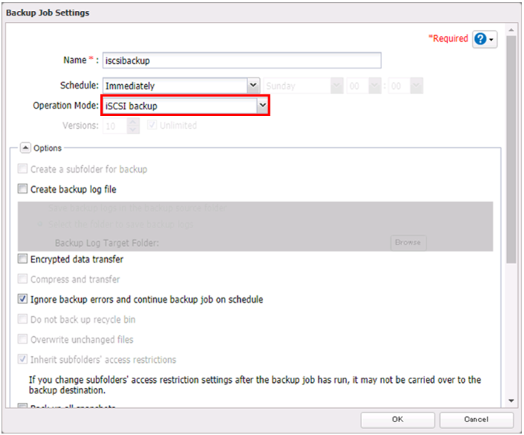
Backing up iSCSI Data
Select iSCSI backup in the standard setup
Notes:
gary

Slide 11
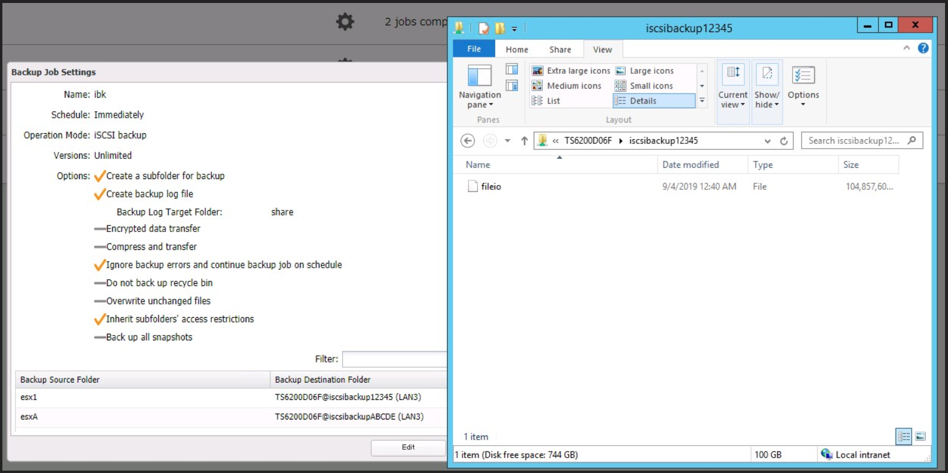
Backing up iSCSI Data
Does not create an iSCSI target on backup destination, saves data to a file
Notes:
gary

Slide 12
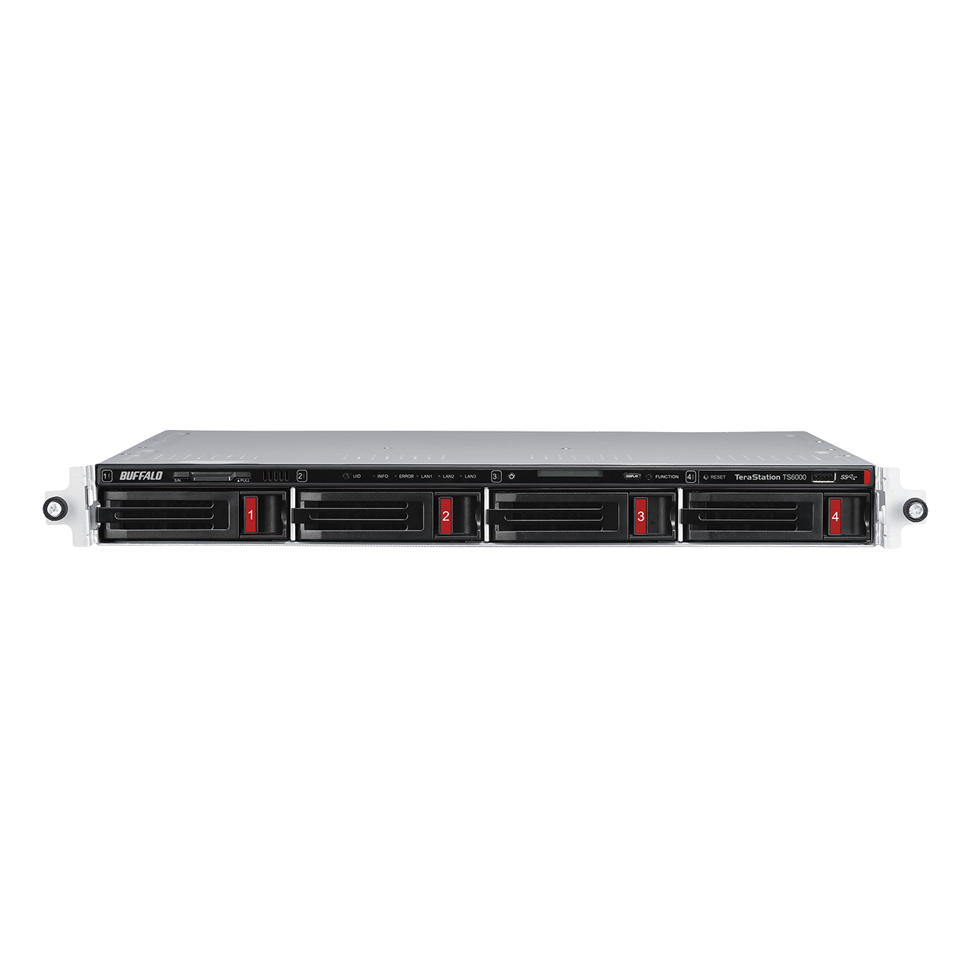
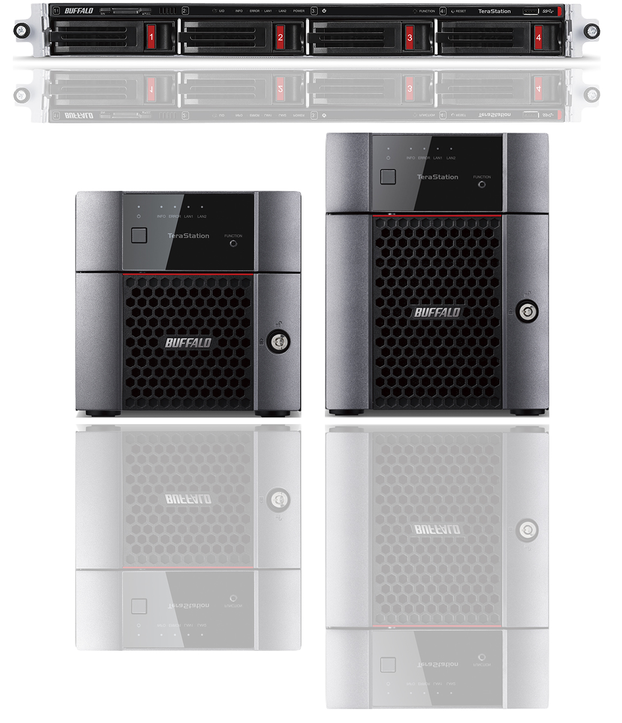
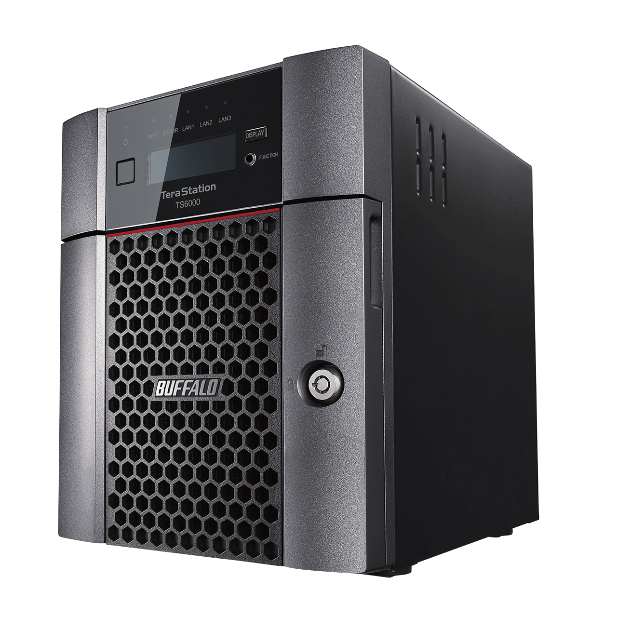
High Performance Buffalo NAS Products
TeraStation
5010 series
TeraStation
6000 series
Use Cases
Client Backup
Migrating old servers
Disaster Recovery
Replication
Storage Virtualization
Surveillance Solutions
Failover
Window Storage Server
Cloud Integration
Vertical Markets
Government – Federal and State and Local – TAA Compliant
Corporate
Healthcare
Education and more
Snapshot
Notes:
mark

Slide 13
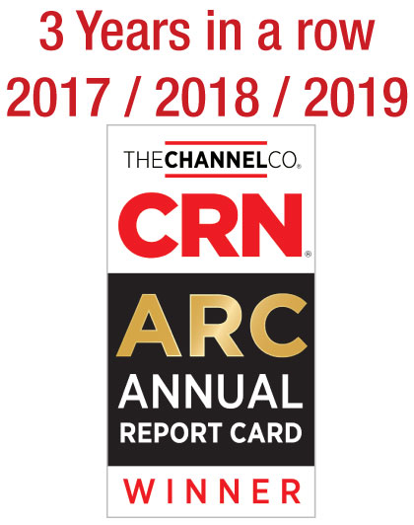
Buffalo Tech Support
Best support will bring your customer back again.
Award winning US-based technical support
Your customers are in award-winning hands with every purchase.
24/7 North American-Based Phone Support
Easy support access for your customers.
FAQs and easy-to-understand walkthroughs
Find answers to common and not-so-common questions at our knowledge base:
Step by Step setup instructions for all TeraStation features
www.buffaloamericas.com/knowledge-base
Up to 60 clients
With full access
Notes:
mark

Slide 14
TeraStation
Purpose Built SMB Storage
Relevant Purpose-built Solution
Many TeraStation storage devices are designed for use by Small Business, SMB, and entry-level Enterprise environments
Ease of use
Our network storage devices come with hard drives included. This means pre-configured RAID and plug and play capabilities & one stop 24x7 US based support by Buffalo
RAID5
Coverage
Dedicated Buffalo representatives standing by to help your customer identify the correct product for their needs
Price
Storage is not the first thought for most small businesses. TeraStations are purpose built for the SMB user with SMB price points in mind
Up to 60 clients
With full access
Notes:
mark

Slide 15
Update
Any Questions?
Contact Information
Mark Green
512-349-1368
Mark.Green@BuffaloAmericas.com
Notes:
mark

