Slide 1
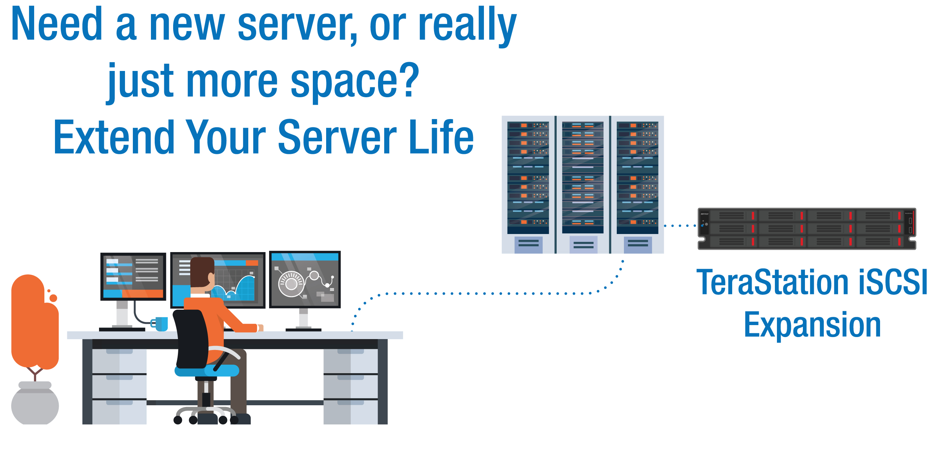
Provide TeraStation NAS to Customers with storage needs & no budget
How Can a Hybrid Cloud Strategy Benefit Your Customer?
Notes:
Mark

Slide 2
Founded in 1974 - 40+ years
Headquarters - Nagoya, Japan
Publically Traded on Tokyo Stock Exchange
North American HQ – Austin, TX
Award winning North American Tech Supporta
Committed to SMB
Purpose Built Engineered Products & Solutions
Dedicated Pre & Post sales resources
Network Storage & Networking Product Strength
Notes:
Mark

Slide 3
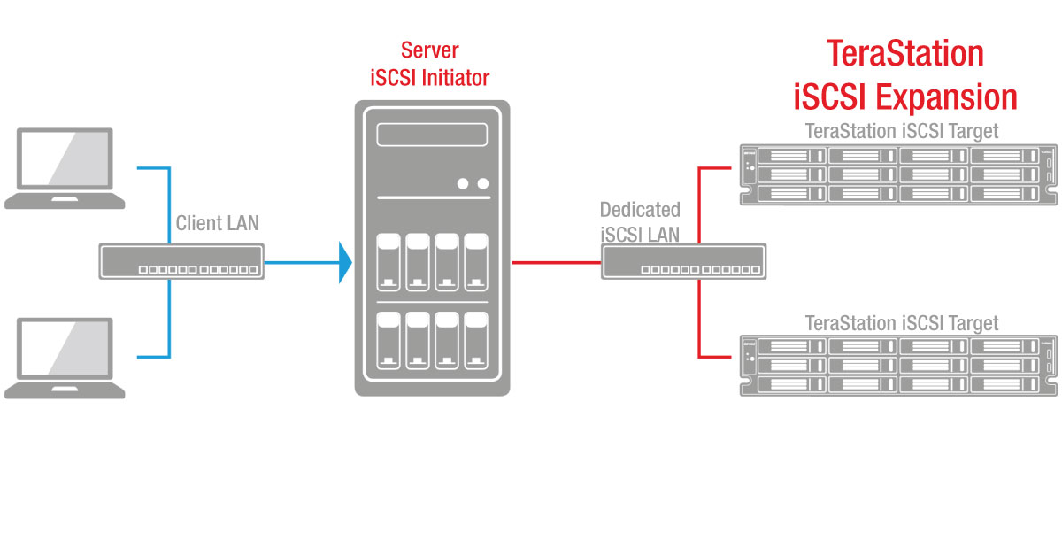
Details about iSCSI
What is iSCSI?
In short, it is an extension of the SCSI (Small Computer Systems Interface) interface to send SCSI commands over an IP network.
It is used so that a virtual host (server) can see a storage media and interact with it.
RAID5
Save yourself the hassle of calling different manufacturers for drive or chassis support
Notes:
Mark

Slide 4
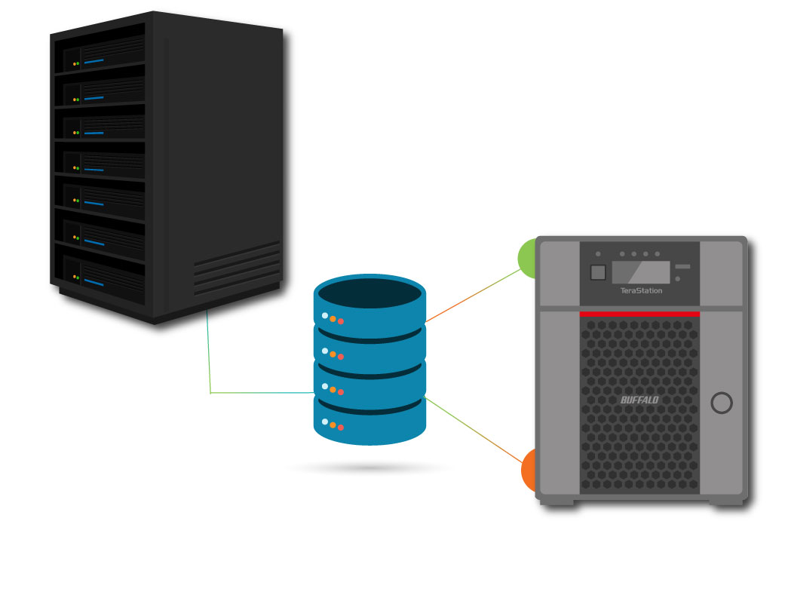
Details about iSCSI
Why is iSCSI relevant?
iSCSI offers the best cost for performance value when adding storage space to a virtual host (server).
RAID5
Save yourself the hassle of calling different manufacturers for drive or chassis support
Notes:
Mark

Slide 5
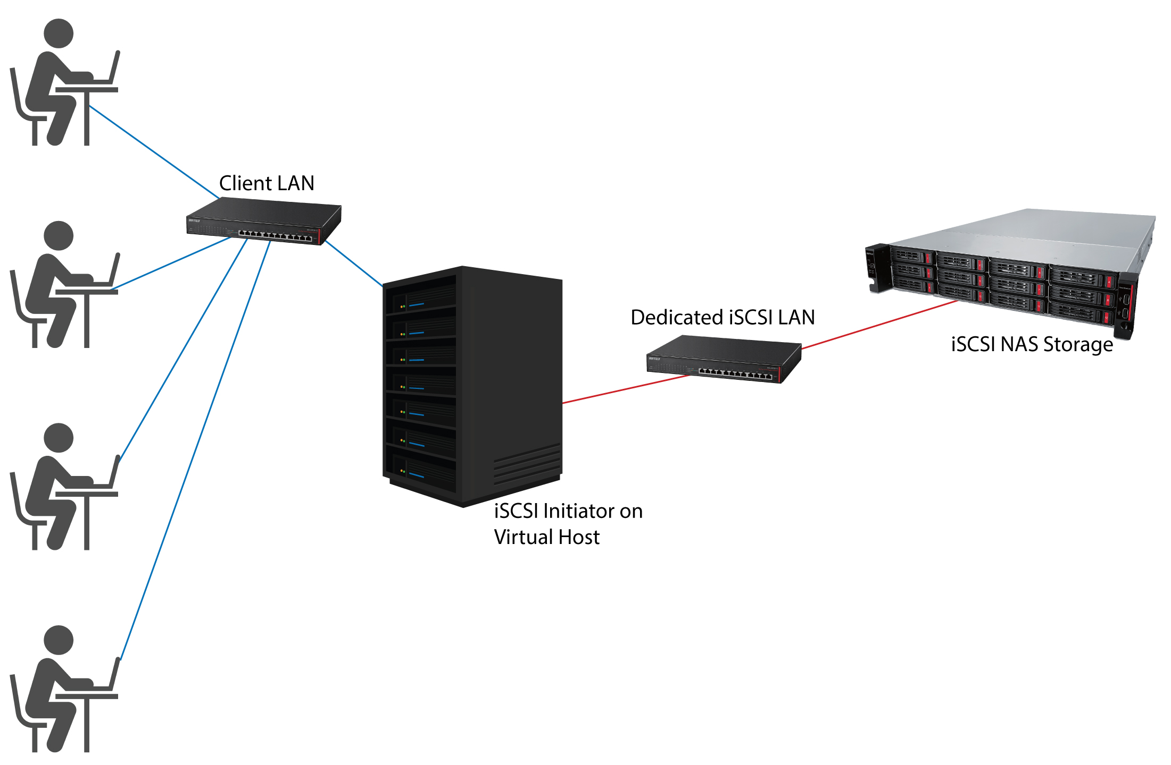
Details about iSCSI
How does iSCSI add storage space to a virtual host (server) while maintaining strong performance?
iSCSI improves PC performance in the network by allowing large storage arrays to connect to client systems without the need for custom hardware or cabling
RAID5
Notes:
Gary

Slide 6
Performance in a Virtual Environment
Benefits
Can provide large amounts of storage to a virtual host (server)
No need to add drives to the host itself
Doesn’t sacrifice performance
Can use existing networking equipment
No need to learn fiber SAN topology configuration
More cost efficient than fiber SAN
RAID5
* A virtual environment is when an operating system creates an environment to host virtual machines (computers).
Notes:
Gary

Slide 7
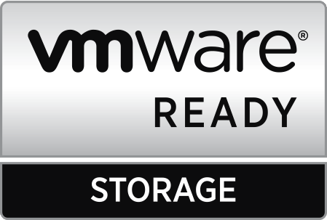
Importance of iSCSI VMware Ready
Why is iSCSI significant to VMware?
VMware ESX provides native support for iSCSI targets. iSCSI is a popular storage option for ESX hosts.
What is VMware Ready?
RAID5
As stated on VMware.com:
VMware Ready designates VMware's highest level of endorsement for products created by our established partners. VMware Technology Alliance Partner members can develop their products to meet VMware standards and submit them for test and review. The VMware Ready certification tests are specifically designed for each category to ensure customer confidence.
Save yourself the hassle of calling different manufacturers for drive or chassis support
If you contact VMware support for assistance with an unsupported storage solution, their ability to help you will be limited *TS5010 only
Notes:
Gary

Slide 8
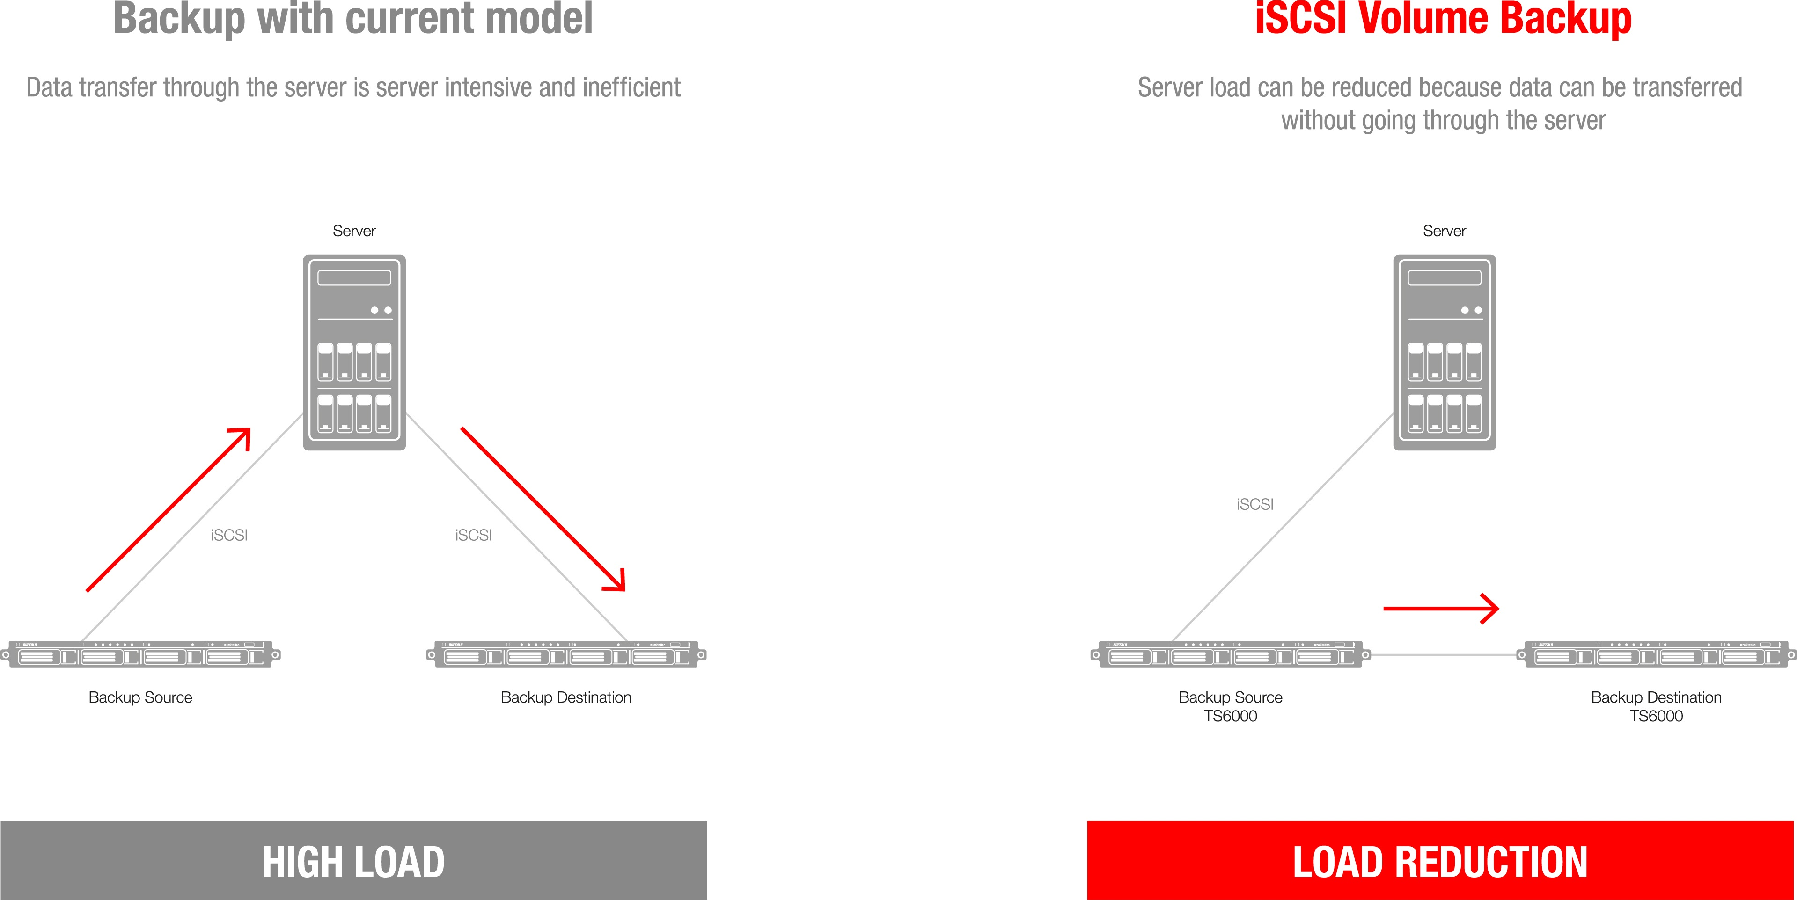
iSCSI Backup with TeraStation 6000
TeraStation 6000 features a game changing iSCSI backup feature that allows you to back up data on one device to another, simply by directly connecting one TeraStation 6000 to the TeraStation already connected to the server.
This drastically reduces bandwidth and bottlenecks, and the direct connection also decreases the likelihood of backup errors occurring.
RAID5
Save yourself the hassle of calling different manufacturers for drive or chassis support
Notes:
Gary

Slide 9
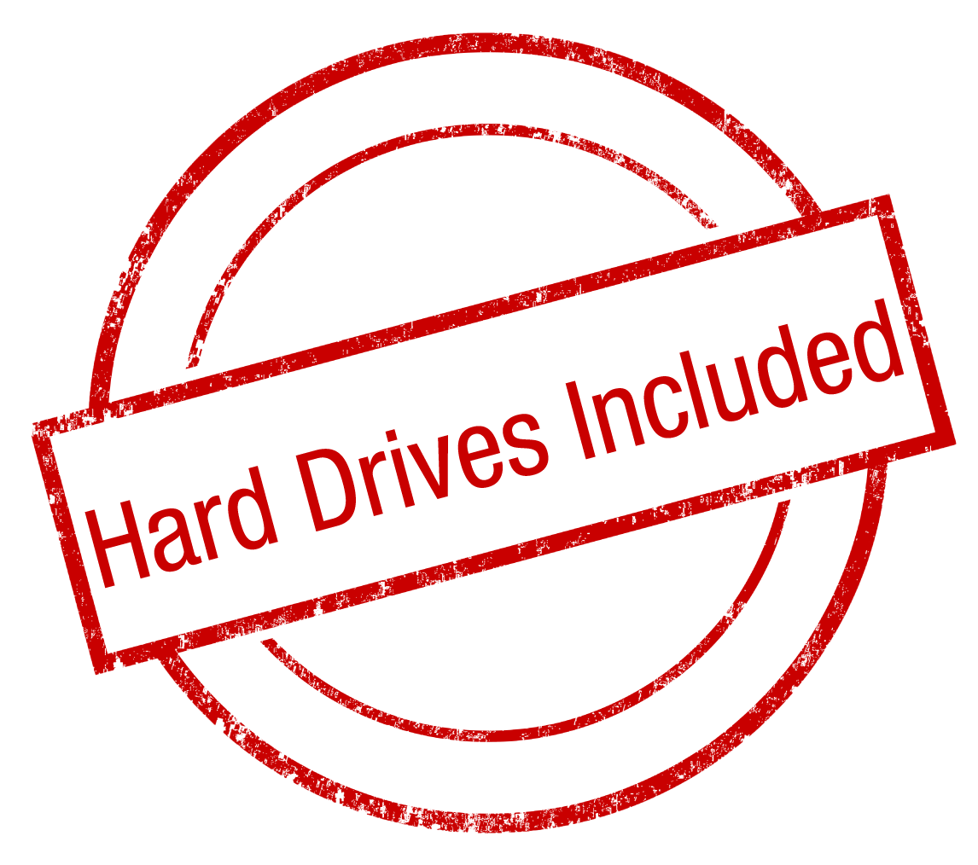
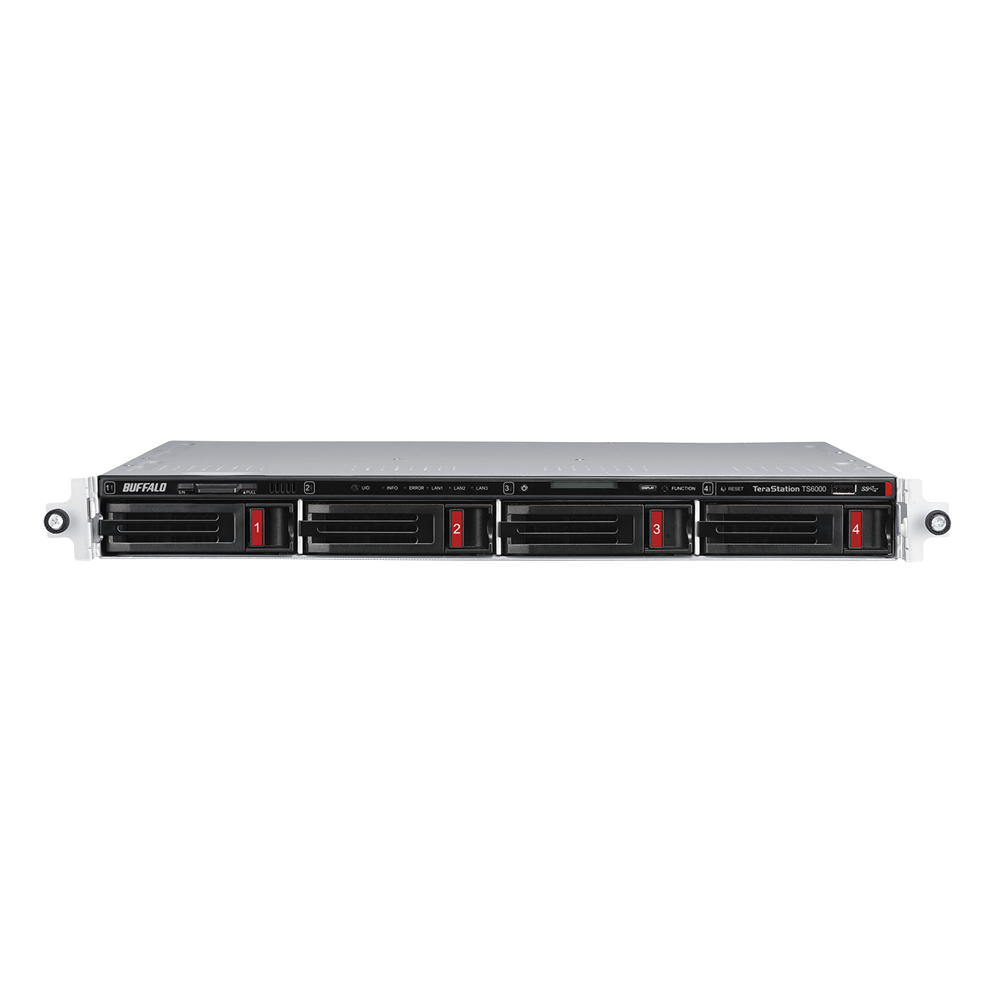
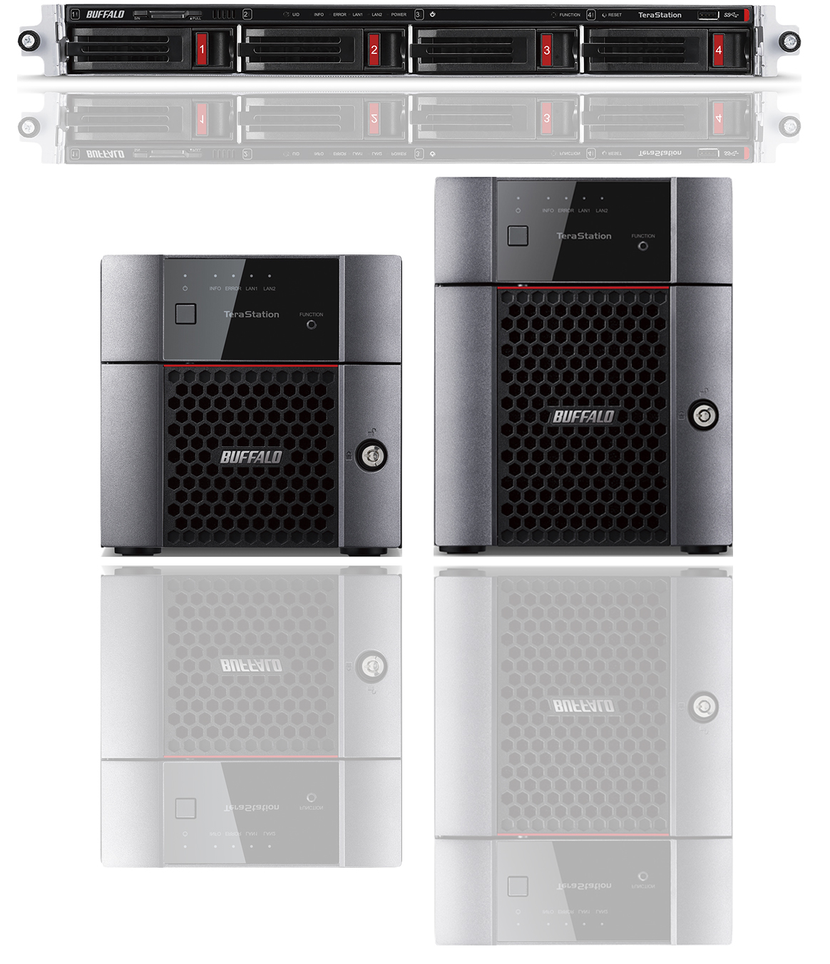
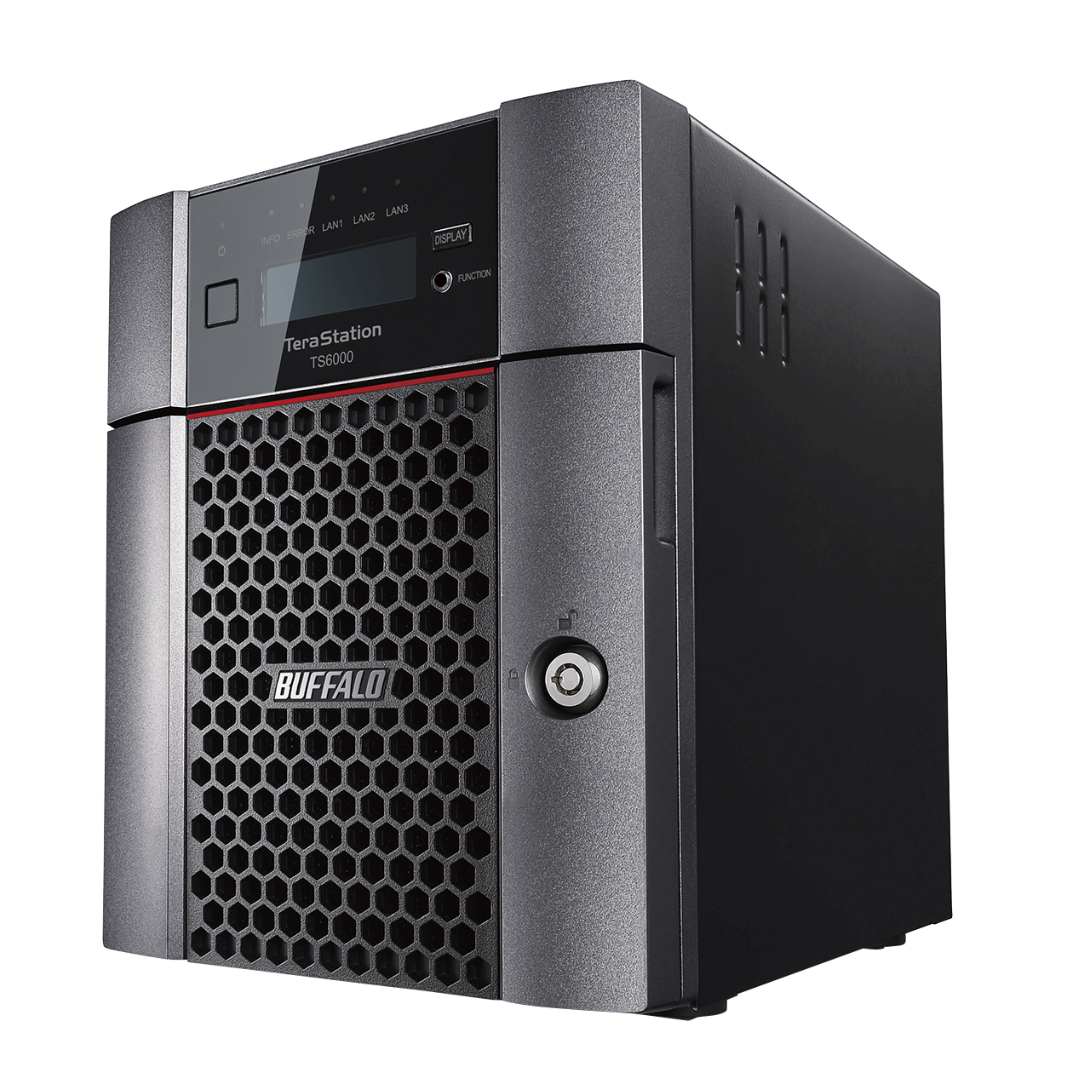
High Performance Buffalo NAS Products
TeraStation
5010 series
TeraStation
6000 series
Use Cases
Client Backup
Migrating old servers
Disaster Recovery
Replication
Storage Virtualization
Surveillance Solutions
Failover
Window Storage Server
Cloud Integration
Vertical Markets
Government – Federal and State and Local – TAA Compliant
Corporate
Healthcare
Education and more
Notes:
Mark

Slide 10
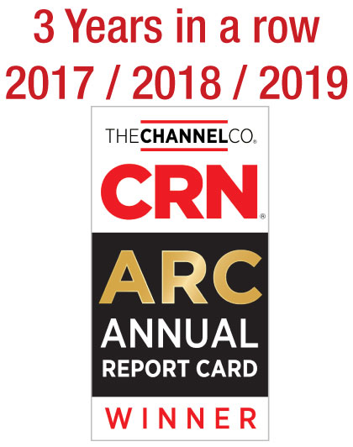
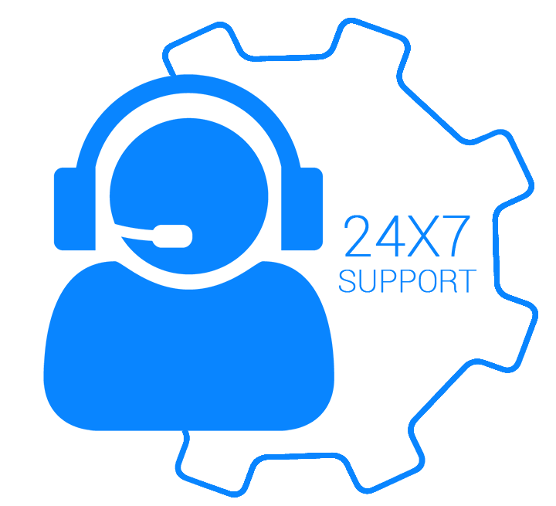
Buffalo Tech Support
Best support will bring your customer back again.
Award winning US-based technical support
Your customers are in award-winning hands with every purchase.
24/7 North American-Based Phone Support
Easy support access for your customers.
FAQs and easy-to-understand walkthroughs
Find answers to common and not-so-common questions at our knowledge base:
Step by Step setup instructions for all TeraStation features
www.buffaloamericas.com/knowledge-base
Up to 60 clients
With full access
Notes:
Mark

Slide 11
TeraStation
Purpose Built SMB Storage
Relevant Purpose-built Solution
Many TeraStation storage devices are designed for use by Small Business, SMB, and entry-level Enterprise environments.
Ease of use
Our network storage devices come with hard drives included. This means pre-configured RAID and plug and play capabilities & one stop 24x7 US based support by Buffalo.
RAID5
Coverage
Dedicated representatives standing by to help your customer identify the correct product for their needs.
Price
Storage is not the first thought for most small businesses. TeraStations are purpose built for the SMB user with SMB price points in mind.
Up to 60 clients
With full access
Notes:
Mark

Slide 12
Update
Any Questions?
Contact Information
800.688.7466
Sales@BuffaloAmericas.com
Notes:
Mark

