Slide 1
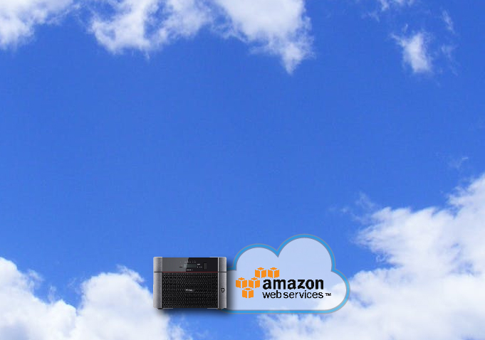

How Can a Hybrid Amazon S3 Strategy Benefit You?
Notes:
Brief introduction by Bill; can introduce speakers from Buffalo
1-2 minutes

Slide 2




Founded in 1974 - 40+ years
  Headquarters - Nagoya, Japan
    Publically Traded on Nikkei
  North American HQ – Austin, TX
  Award winning North American Tech Support
  a
Committed to SMB
  Purpose Built Engineered Products & Solutions
  CDW dedicated resources
Network Storage & Networking Product Strength
Notes:
Arthur

Slide 3
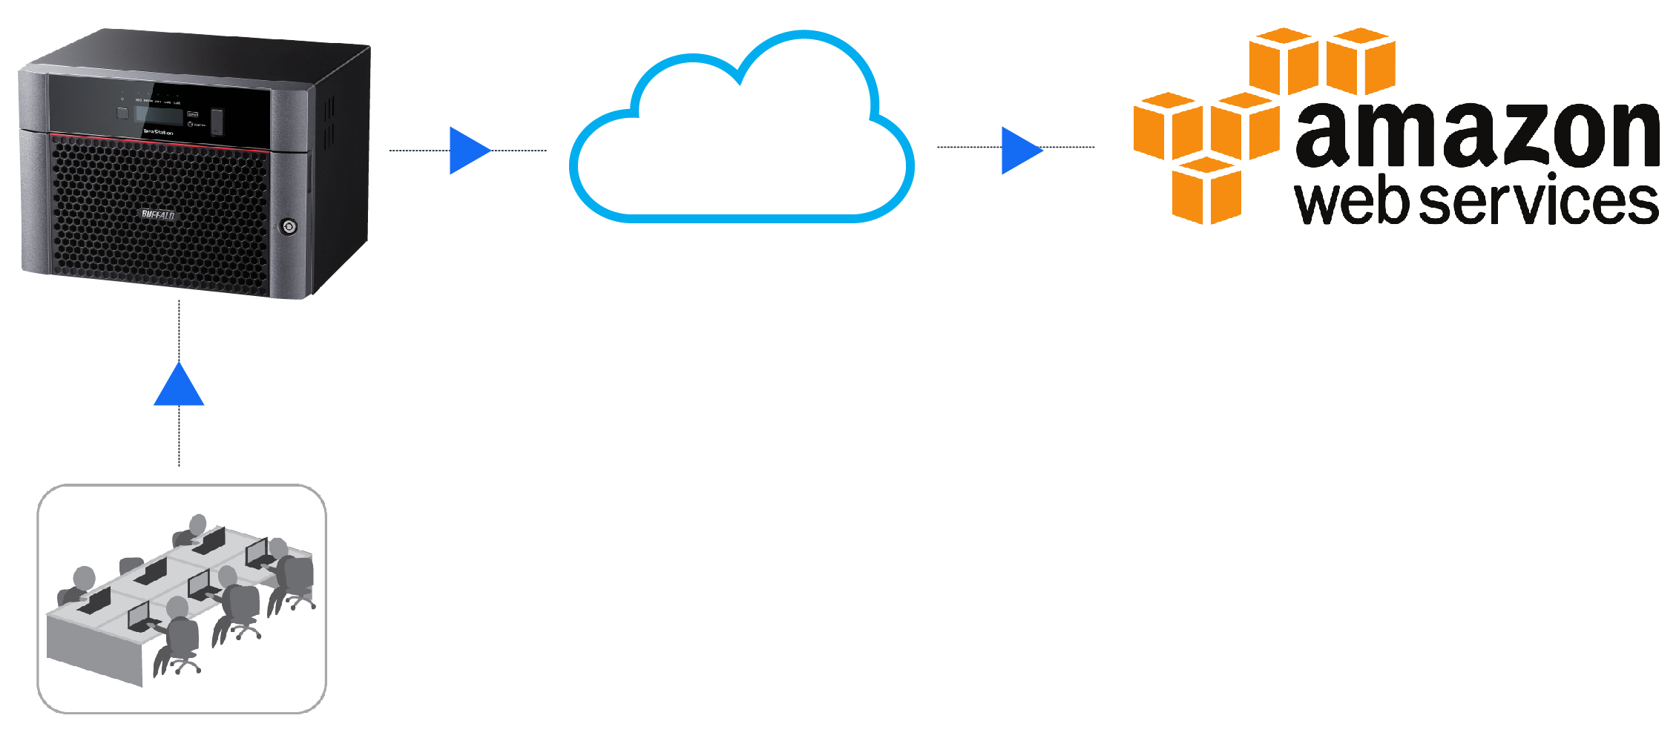
What is a Hybrid Cloud Strategy?
Hybrid Cloud strategies include cloud and local (terrestrial) storage
RAID5
Save yourself the hassle of calling different manufacturers for drive or chassis support
Benefits Include:
Faster Data Access - Synchronized Data - Data Security,
Cost Savings - Faster Recovery - Increased Efficiency
Notes:
Mike

Slide 4
Benefits of Hybrid Cloud Strategy
Faster Access
Accessing files from your S3 account can take time, especially if they are large. When your data is also stored locally, you enjoy immediate file access
RAID5
Synchronized Data
Changes to locally stored data can be synced with cloud files as desired
Data Security
Select which data you want stored in the Cloud. Desired files are backed up to the Cloud. Sensitive data is stored locally for greater security
Notes:
Mike

Slide 5

Why add a Hybrid Cloud?
Save Money
Cumulative Cloud storage fees are not often realized upfront. Prioritize data that is stored in the Cloud to minimize costs
Recover Faster
RAID5
Local storage offers immediate file recovery. Cloud based file recovery can be lengthy, depends on bandwidth
Be More Efficient
Improve work hour efficiency by scheduling Cloud backups after hours preserving available bandwidth during the day
Notes:
Mike

Slide 6

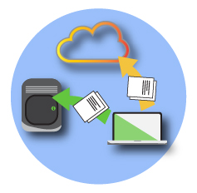
Net Neutrality and my S3 costs
Net Neutrality has been repealed; many expect service providers to impose new bandwidth usage guidelines, resulting in more expensive internet service and/or public cloud services like Amazon S3
RAID5
Buffalo TeraStation network attached storage (NAS) products support native Amazon S3 integration at no additional charge
Notes:
Mike

Slide 7

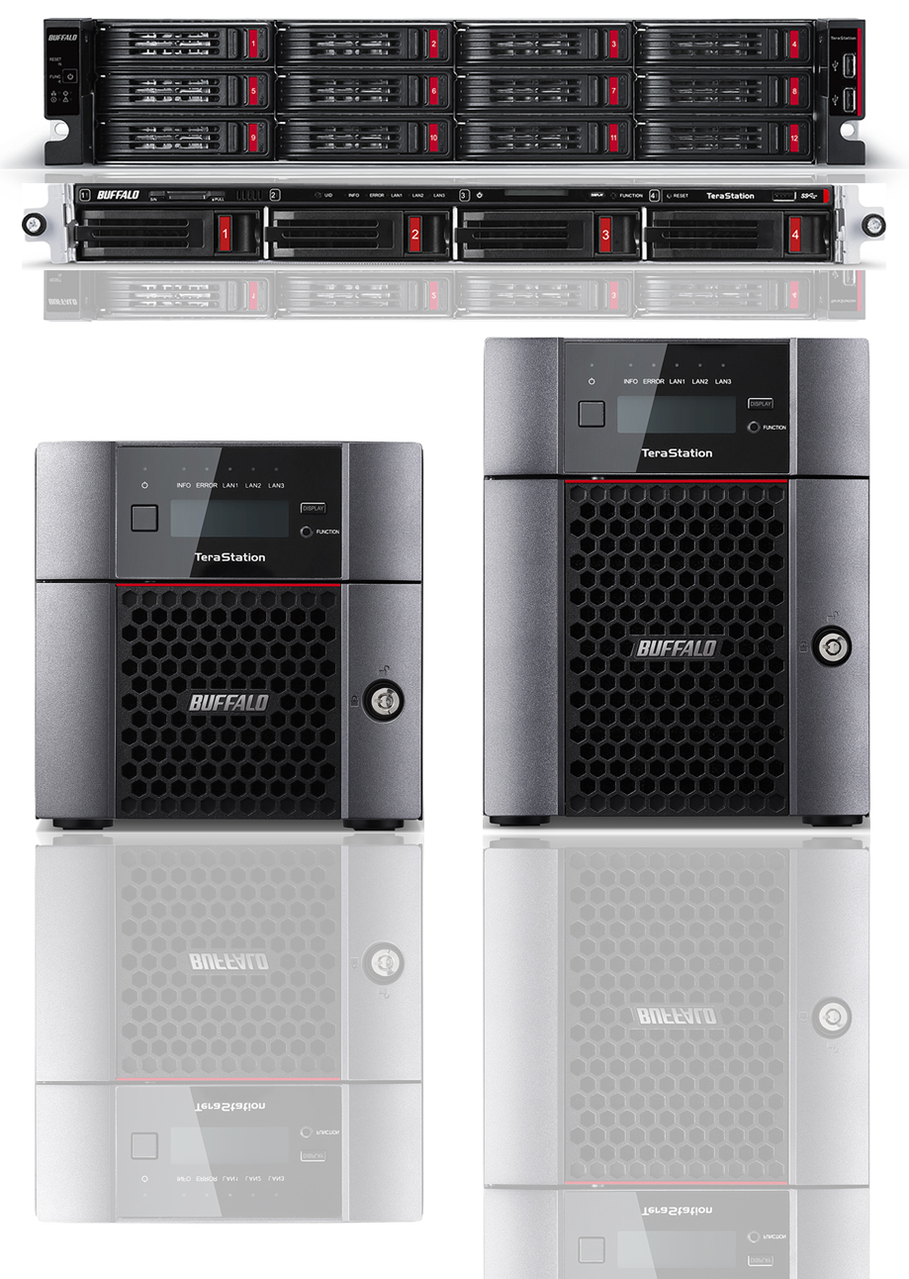
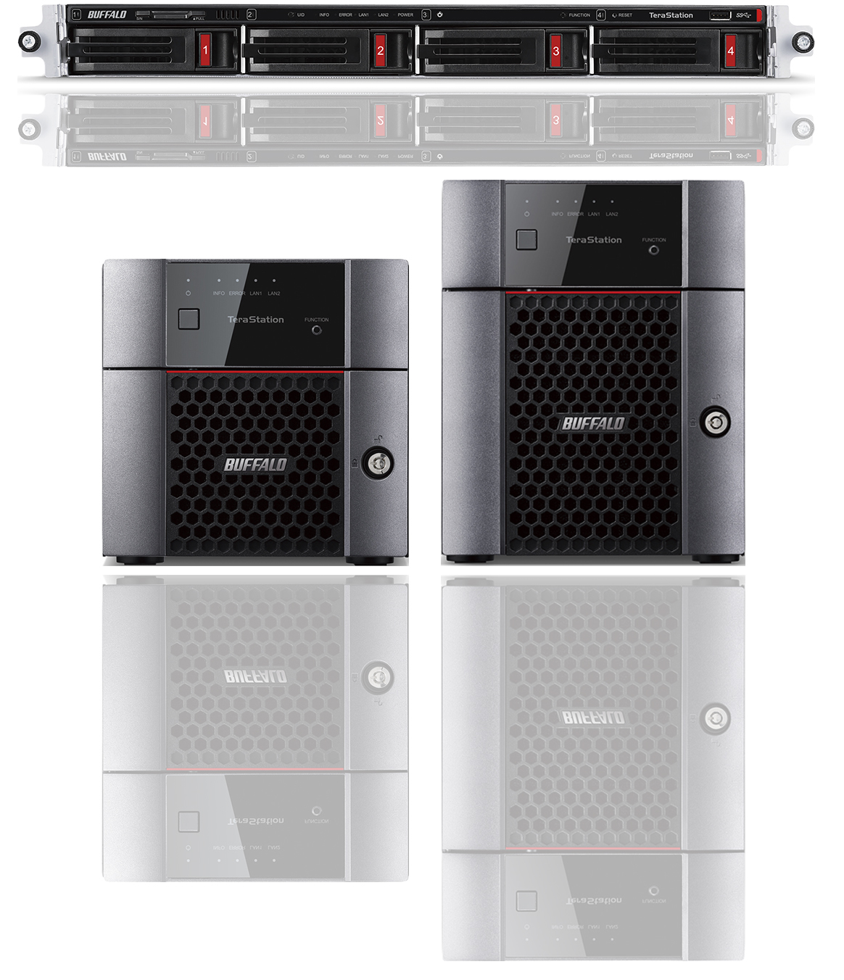
New Buffalo NAS Products
TeraStation 3010 series
TeraStation 5010 series
  Use Cases
    Hybrid Cloud (featuring Amazon S3)
    Basic File Server
    iSCSI Storage
    Backup Target
    Offsite Backup
    Disaster Recovery
    Surveillance Storage
Notes:
Mike

Slide 8
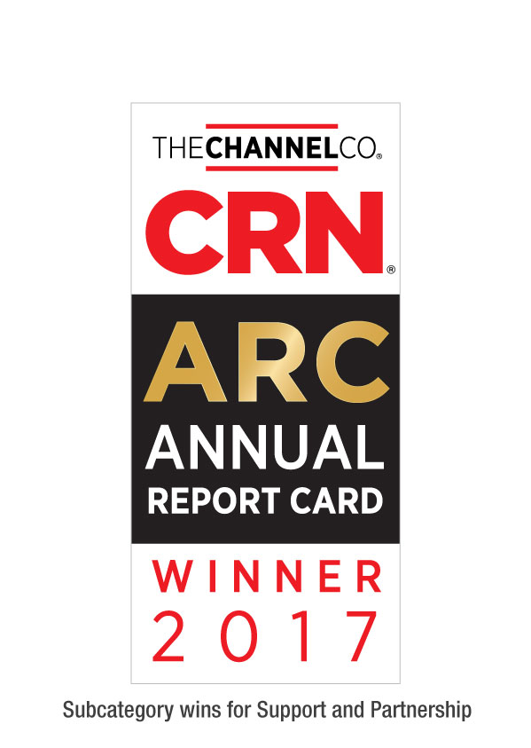


Tech Support
Award winning US based technical support
RAID5
24/7 North American-Based Phone Support
Find answers to common and not so common questions at our knowledge base
Step by Step setup instructions for all TeraStation features
www.buffaloamericas.com/knowledge-base
Up to 60 clients
With full access
Notes:
Andrew

